Slide 1
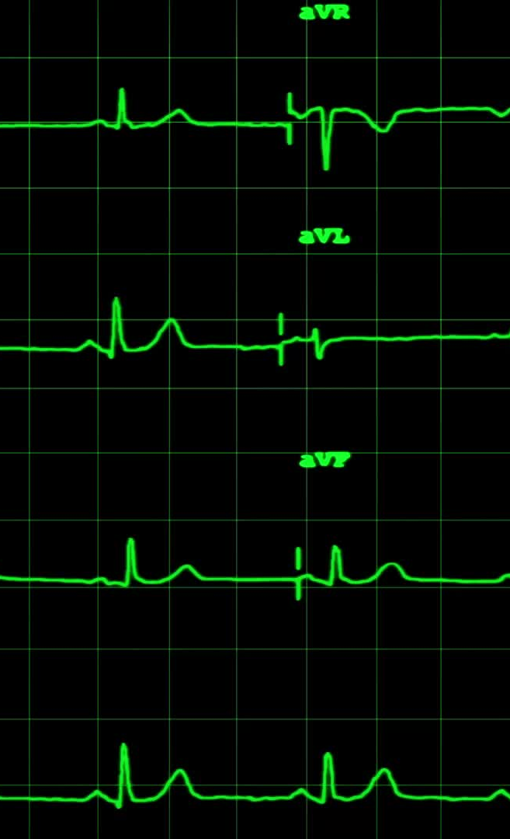
A Deep Convolutional Neural Network Model To Classify Heartbeats
Original Authors:
U. Rajendra Acharya, Shu Lih Oh, Yuki Hagiwara, Jen Hong Tan, Muhammad Adam, Arkadiusz Gertych, Ru San Tan
Published Aug. 2017
Presented by:
Mudiaga Ovuede, Elaheh Rajabi, Jake Zhu

Slide 2
Introduction: Cardiovascular Diseases (CVDs)
Cardiovascular diseases (CVDs) are the top cause of mortality (according to World Health Organization( WHO) approximately 17.7 million people died in 2015
There are 3 broad groups of CVDs :
electrical (arrhythmia, or abnormal heartbeats)
Life-threatening
Non-life-threatening (focus of this presentation)
circulatory (blood vessels disorder)
structural (heart muscle diseases)

Slide 3
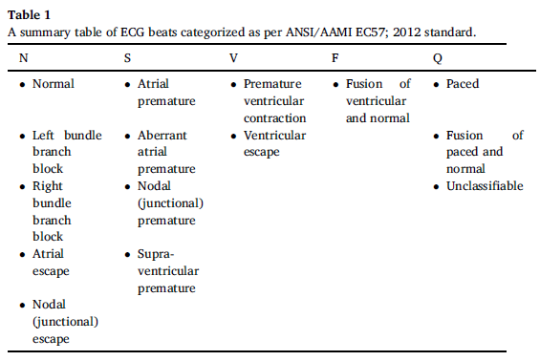
Categories of Non-Life-Threatening Heartbeats
Non-ectopic (N)
Ectopic = abnormal
Supraventricular ectopic (S)
Lower chambers of the heart/ventricles
Ventricular ectopic (V)
Area above the ventricles, atria
Fusion (F)
Unknown beats (Q)

Slide 4
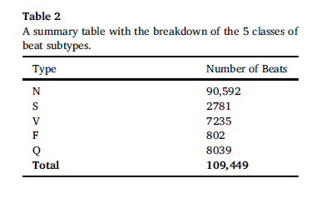
Electrocardiogram (ECG) Database
ECG data base – open source PhysioBank MIT-BIH Arrhythmia database (BIH: Boston's Beth Israel Hospital, now Beth Israel Deaconess Medical Center; data collected between 1975 and 1979)
Data initially sorted by cardiologists
48-half-hour long ECG recordings from 47 subjects obtained with Lead II ECG signal
Each signal is sampled at 360Hz (360 samples per second), and each ECG beat is 260 samples long
A total of 109,449 ECG beats are extracted
Data Set A & Set B (de-noised)
$$Total \# ECG beats=48∗0.5hour ∗\frac{60min}{1hour}∗\frac{60sec}{1min}∗\frac{360sample}{1sec}∗\frac{1beat}{260sample}≈109,449 beats$$

Slide 5
Data Preparation of Classes
All ECG signals are centered around the detected maximum amplitude of waves ( R-peaks)
each class is normalized using Z-score normalization before feeding into the CNN network for training and testing
Z = (x – mu) / sd
To balance the classes, the samples of synthetic data are generated after preprocessing by varying the standard deviation and mean of Z-score calculated from the original normalized ECG signals

Slide 6
Generation of Synthetic Data to Balance Classes
N class remains unchanged because they are the most abundant.
The size of the other classes are increased by adding synthetic sample data
After balancing, the total number of cases has increased to 452,960 beats.
Class | Class Size
N | 90,592
S | 90,592
V | 90,592
F | 90,592
Q | 90,592
Total Cases = 452,960

Slide 7
Pre-processing Summary
set A: consists of original ECG signals with noise
set B: consists of ECG signals that passed through a noise attenuating digital filter(without noise)
CNN model will be trained with set A and then set B. The performance of the CNN is evaluated separately on set A and set B to assess its ability to handle noisy data
Noise and baseline Removal
ECG heartbeat classifying
Z-score normalization

Slide 8
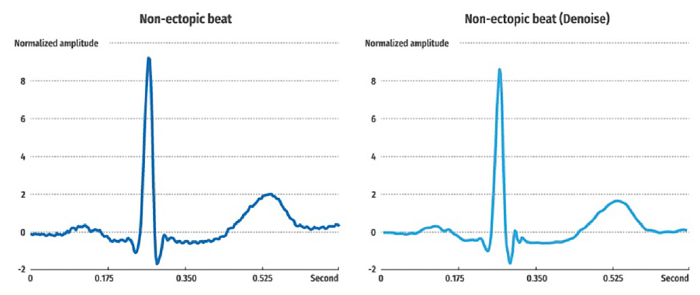
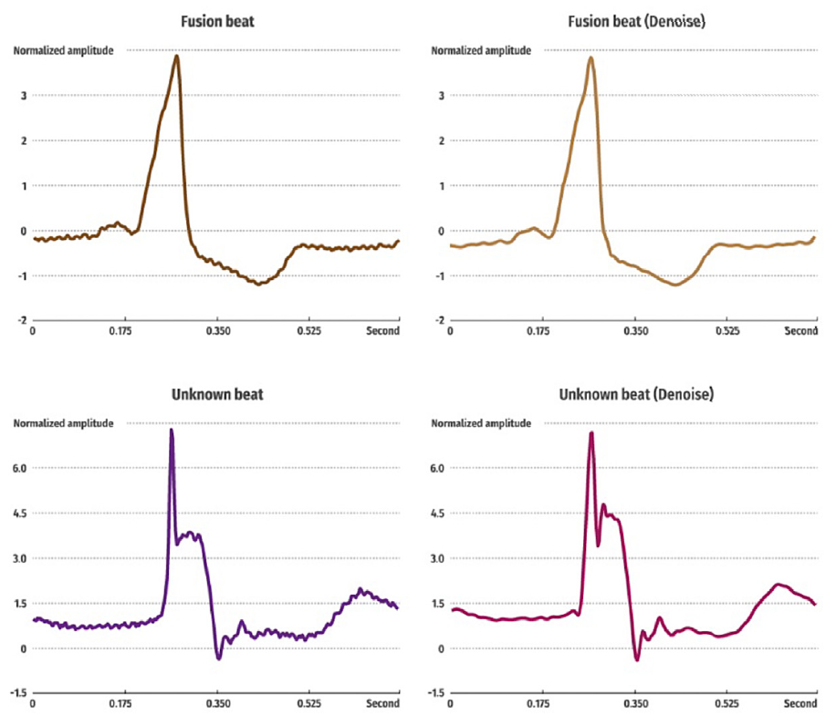
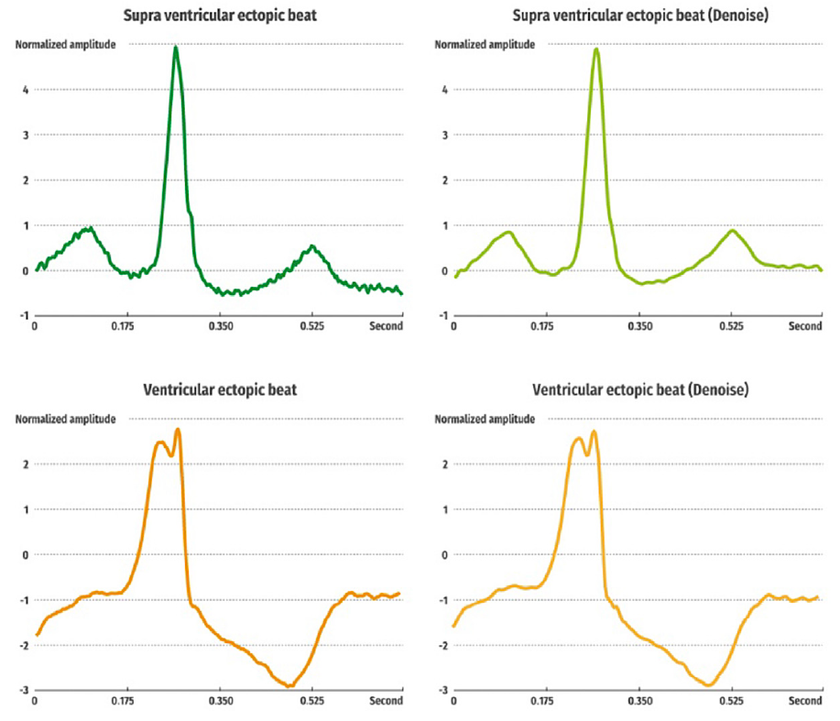

Slide 9
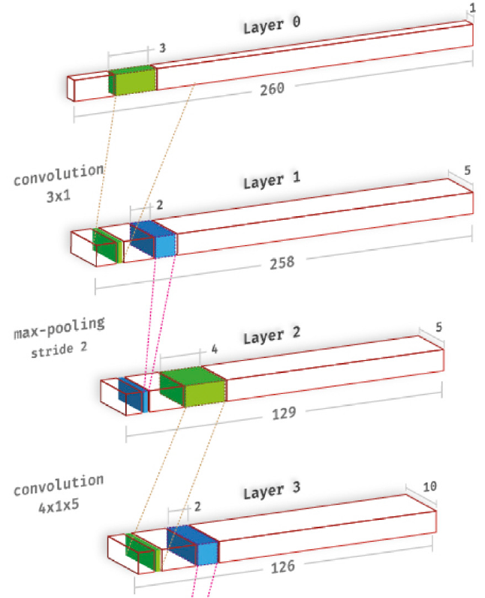
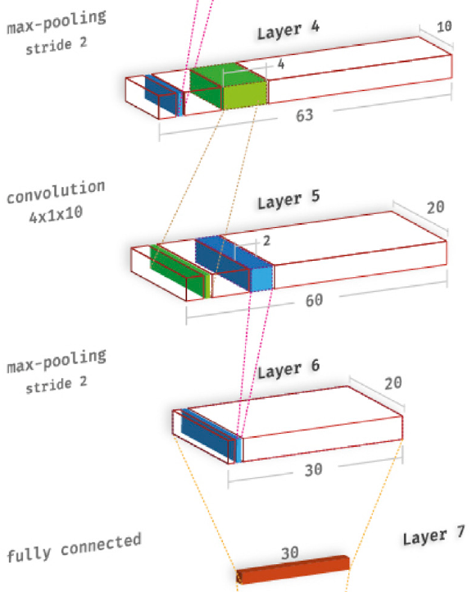
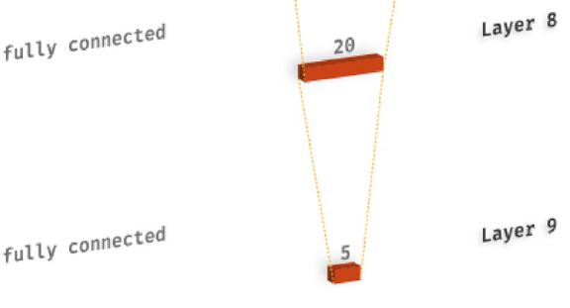
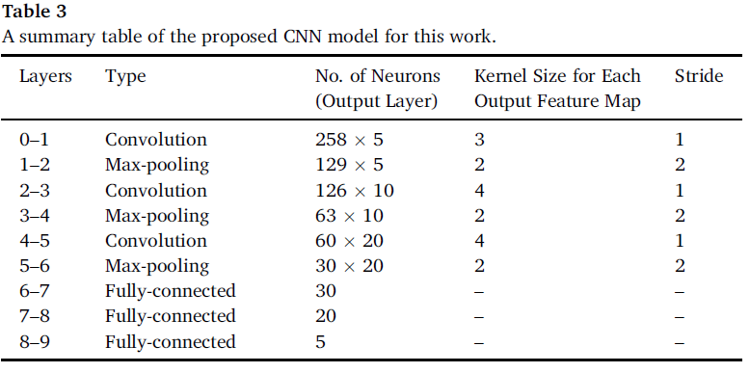
CNN Architecture
$$Output_{maxpool}=\left(Input −Filtersize\right)+1$$

Slide 10
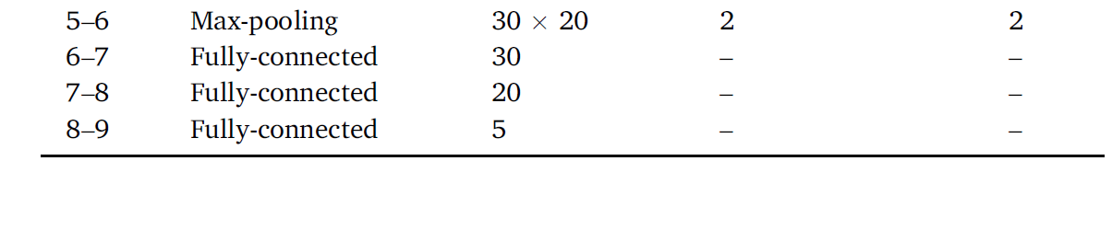
Number of Weights and Thresholds
Dim(L6) = 600 neurons -> Dim(L7) = 30 neurons -> Dim(L8) = 20 neurons -> Dim(L9) = 5 neurons -> SoftMax
# Weights = (600*30) + (30*20) + (20*5) = 18000 + 600 + 100 = 18,700
# Thresholds = 30 + 20 + 5 = 55
# Parameters = 18,755

Slide 11
Parsimony Ratio Calculation
Each heartbeat consists of 260 samples
Classification into 5, therefore each data brings 5 info
Total # info = 5 x (9/10) x 452,960 = 2,038,320
Parsimony ratio = (Total # info) / (# parameters) =
2,038,320 / 18,755 = 108
There is enough information to fulfil parsimony principle.

Slide 12
Observation Parameters
Specificity
Measure of how well ECG test can correctly identify patients who do NOT have a certain condition
True negative results (patients without condition who test negative)
= Patients who test true negative / all patients without condition
High specificity means test good at ruling out patients who do not have condition
May result in higher rate of false negatives
Sensitivity
Measure of how well ECG test can correctly identify patients who DO have a certain condition
True positive results (patients with condition who test positive)
= Patients who test true positive / all patients without condition
High sensitivity means test good at ruling out patients who do have condition
May result in higher rate of false positives
Accuracy
Measure of overall diagnostic performance
Proportion of all correct results (both true positive and true negative)
= all correct results / all patients tested
High accuracy means test good at correctly identifying both patients with condition and those without it

Slide 13
Training Technique
Training was done in 20 epochs
Validation done after every epoch
90% used for training data
10% used for testing data
10-fold cross-validation is employed
Rotation of test data 10 different times, randomly divided
Hyperparameters:
Regularization (gamma): 0.2
Learning rate: 3 x 10^-3
Momentum (SGD): 0.7
Observing parameters averaged over 10 tests:
Sensitivity (%)
Specificity (%)
Accuracy (%)
Runtime: approximately 9573.2s per epoch for set A and 9586.7s for set B per epoch
Hardware: two Intel Xeon 2.40 GHz (E5620) processors and 24 GB of RAM

Slide 14
Results and Discussion
The performance of data set A and the de-noise data set B showed comparable performance.
Training time: 9573.2s and 9586.7s per epoch for set A and B respectively (~20epochs = 53hrs).
Large number of images is required for training.
Skewed (Imbalanced) data presented a real issue and was necessary.
Imbalanced Set (Accuracy %) |  |  | Balanced Set (Accuracy %)
Set A | Set B |  | Set A | Set B
89.07% | 89.03% |  | 93.47% | 94.03%

Slide 15
Results and Discussion cont.
Confusion Matrix for ECG heartbeat classification, set A and set B
 | Set A | Set B
Correctly Classified | >88% | >90%
Missed Classified | <12% | <10%
Lowest PPV | Class N: 85% | Class N: 87%

Slide 16
Overall Performance Across All Ten-Folds
 | TP | TN | FP | FN | acc(%) TP+TN/ (TP+TN+FP+FN) | ppv(%) TP/(TP+FP) | sen(%) TP/(TP+FN) | spec(%) TN/(TN+FP)
Set A | 76.81% | 18.33% | 1.67% | 3.19% | 93.47 | 97.87 | 96.01 | 91.64
Set B | 77.37% | 18.31% | 1.69% | 2.63% | 94.03 | 97.86 | 96.71 | 91.54
acc = accuracy, ppv = positive predictive value, sen = sensitivity, spec = specificity.
True positive (TP) number of the positive
True negative (TN) number negative
False positive (FP) number of mistaken identified to the positive
False negative (FN) number of mistaken identified to the negative

Slide 17
Limitations of this proposed CNN model:
Long training time, need of specialized hardware (GPU) to efficiently train
The requirement of a very large number of images to train the model to reliably recognize multiple patterns

Slide 18
Benefits of this proposed CNN model
Full automation, no need for additional feature extraction, selection, or classification.
Insensitivity to ECG signal quality (The performance of CNN on Set A and set B are almost same)
Implementation of a ten-fold cross-validation (thus boosting the robustness of the model)

Slide 19

Possible Use Cases
ECG heartbeat signals is fast once the training is complete and can be deployed in clinical settings to aid cardiologists in making objective diagnoses of ECG heartbeat signals.
It can be utilized in intensive care units (ICUs) and rural areas where medical care is not readily accessible.

